Slide 1
Hire Heroes USA
Volunteer Program Analysis
Ekaterina Klokova
Shannon Ramsey
Joshua Shepko
Kwadwo Kyei
Ivan Matic

Slide 2
Volunteer Program Business Questions
What can we prove - quantitatively - that our volunteers are increasing the overall effectiveness of our program?
Does working with a volunteer raise the probability of a client getting hired or getting hired sooner?
Are there certain Mentoring activities that are more effective than others?
Do volunteer activities increase the quality of job obtained - like the salary level?

Slide 3
Business & Data Understanding
Understand the Hire Heroes organization
Challenge overview & Hire Heroes website
Understand the Data
Examined data dictionary
Examined data tables
Examined supplementary materials
Identified useful data in 3 tables
SalesForce_Case
SalesForce_Contact
SalesForce_Hire_Information__c

Slide 4
Data Preparation
Joined 3 data tables using primary keys
SalesForce_Case - ContactId
SalesForce_Contact - Id
SalesForce_Hire_Information__c - Client_Name__c
Cleaned data
Remove null values
Remove unneeded columns
Created new fields
Calculated fields - time to hire
Delimited text to columns - salary

Slide 5
Does working with a volunteer raise the probability of a client getting hired?
23 % - Overall Hire Rate
66% - Hire Rate for Clients who used Volunteer Services

Slide 6
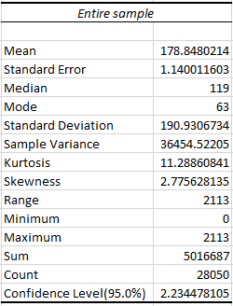
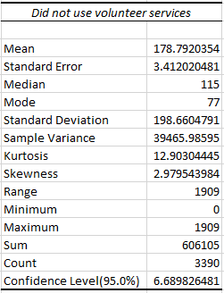
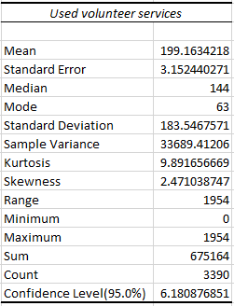
Does working with a volunteer raise the probability of a client getting hired sooner?

Slide 7
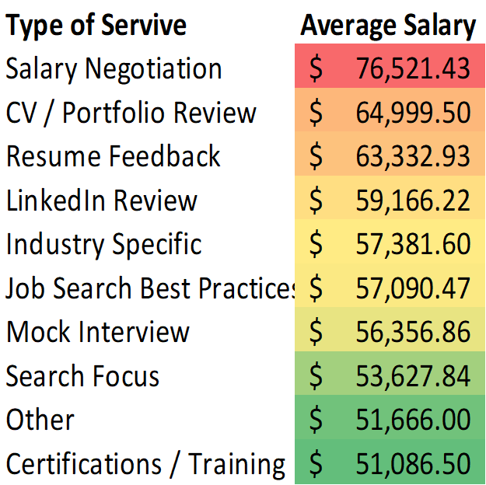
Mentoring Activities

Slide 8
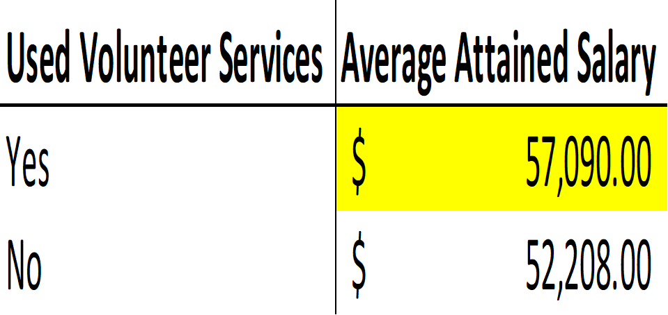
Do volunteer activities increase the quality of job obtained - like the salary level?

Slide 9
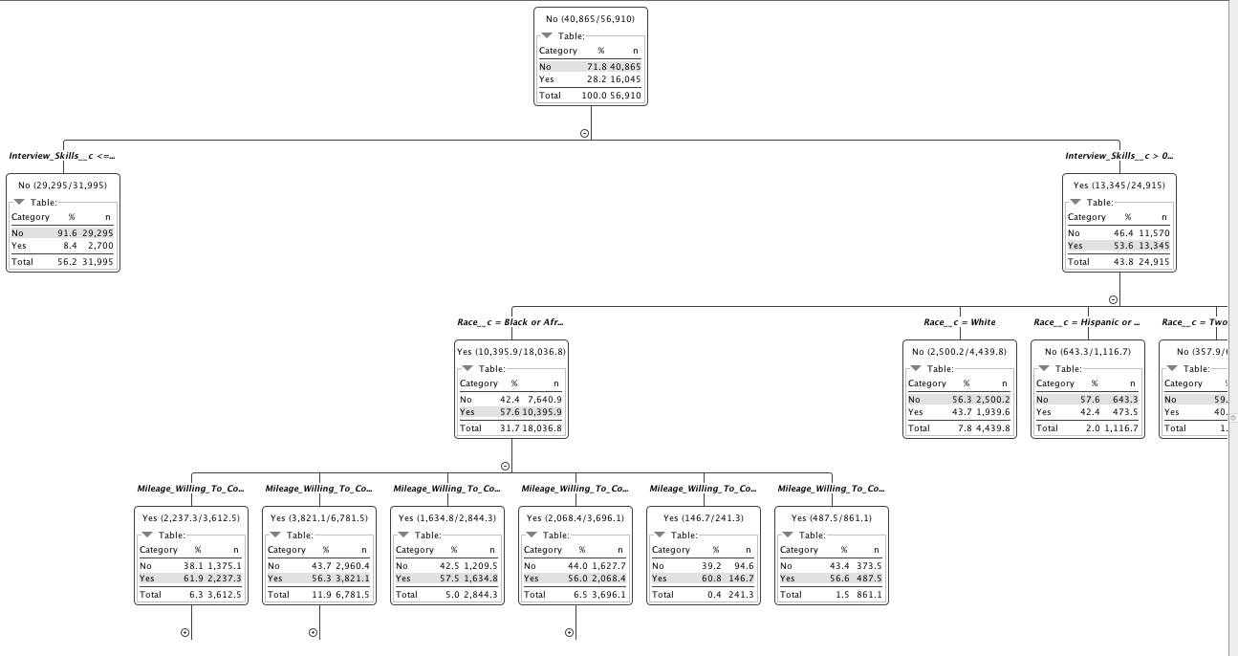
Decision Tree

Slide 10
Recommendations
Recommendations for Hired Hero’s Data:
Include more data for each variable
Include better descriptions for the variables in the Data Dictionary
Recommendations for Hired Hero’s volunteer services:
Focus on expanding volunteer services since they are proven to help attain a higher salary
Expand on mentoring services offered by Hired Hero’s their volunteer program

